Slide 1

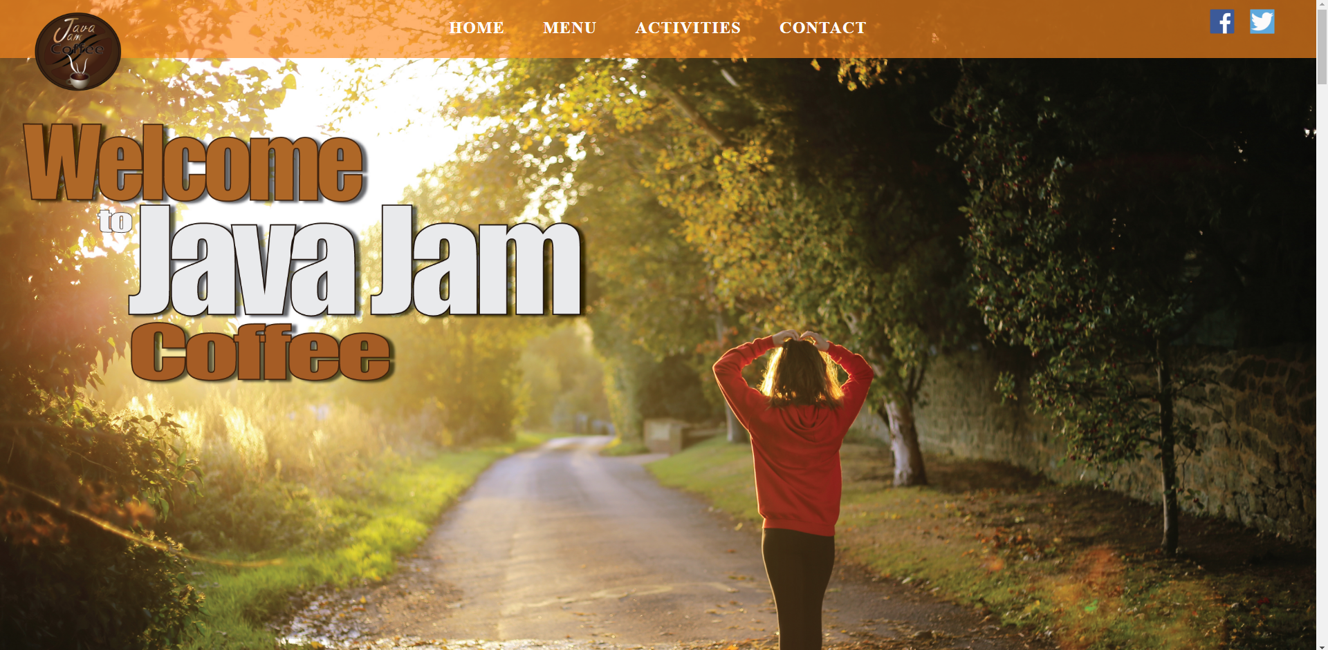
Java Jam Coffee
Planning
Design
Conclusion

Slide 2

Planning
This is a very important aspect of web design. It is necessary to analyze what looks good, works well and useful to your users.
http://www.mesutoezil.com/

Slide 3

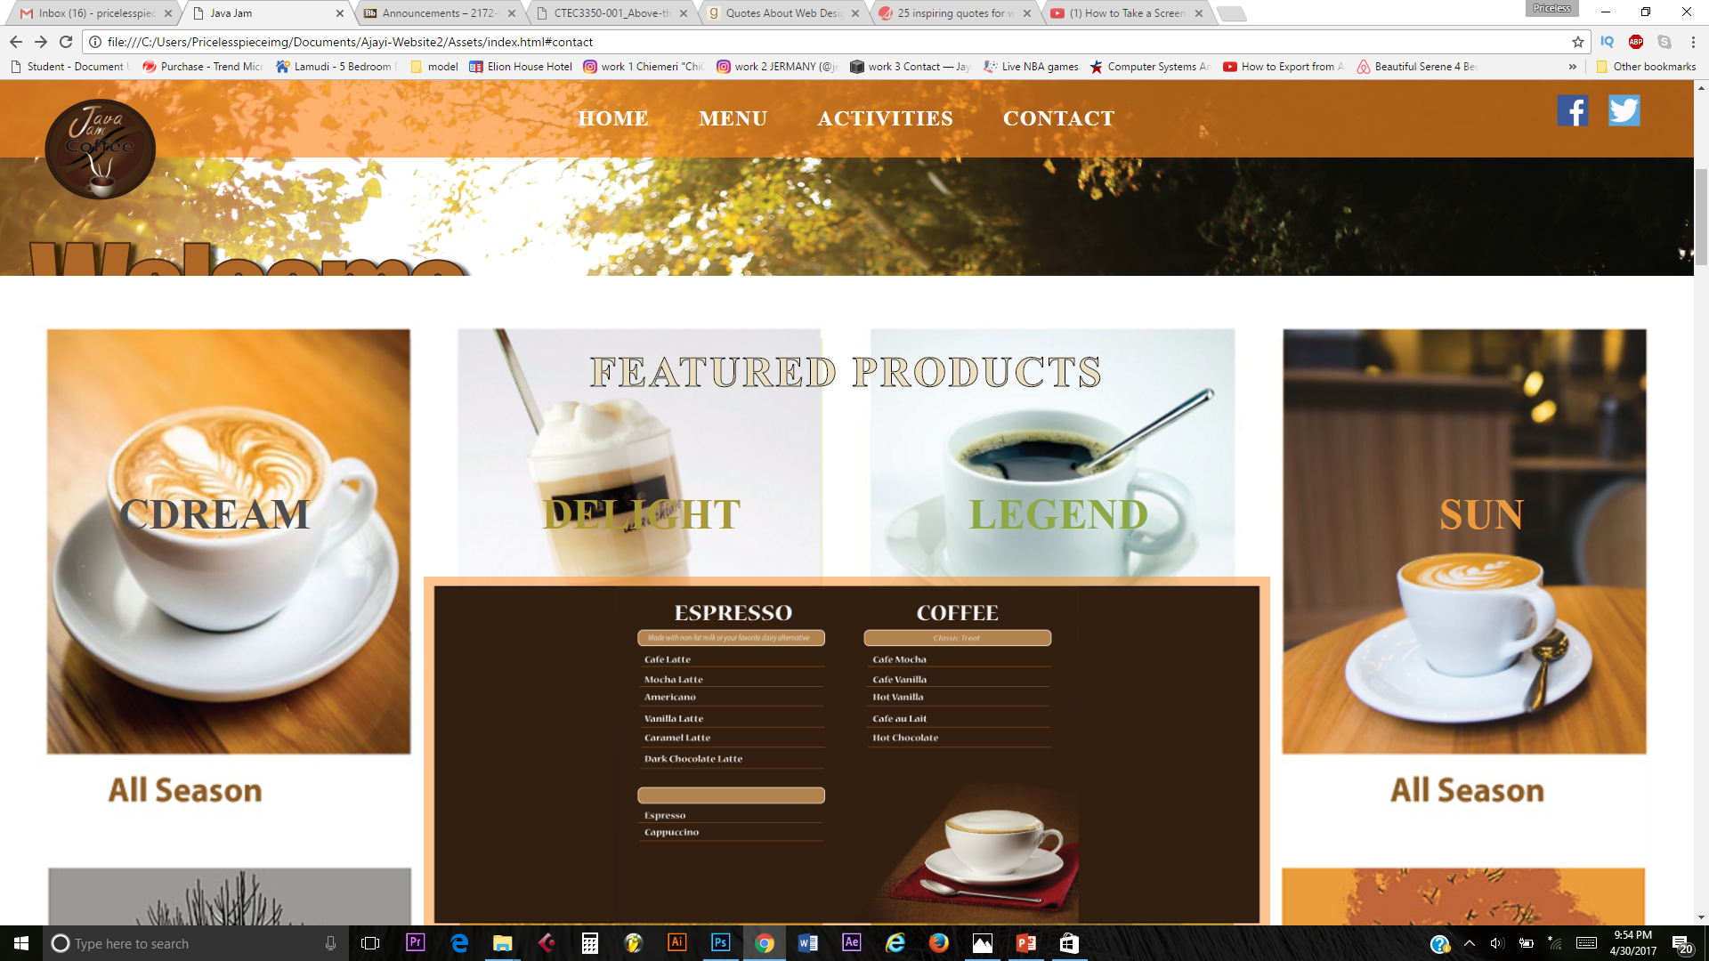
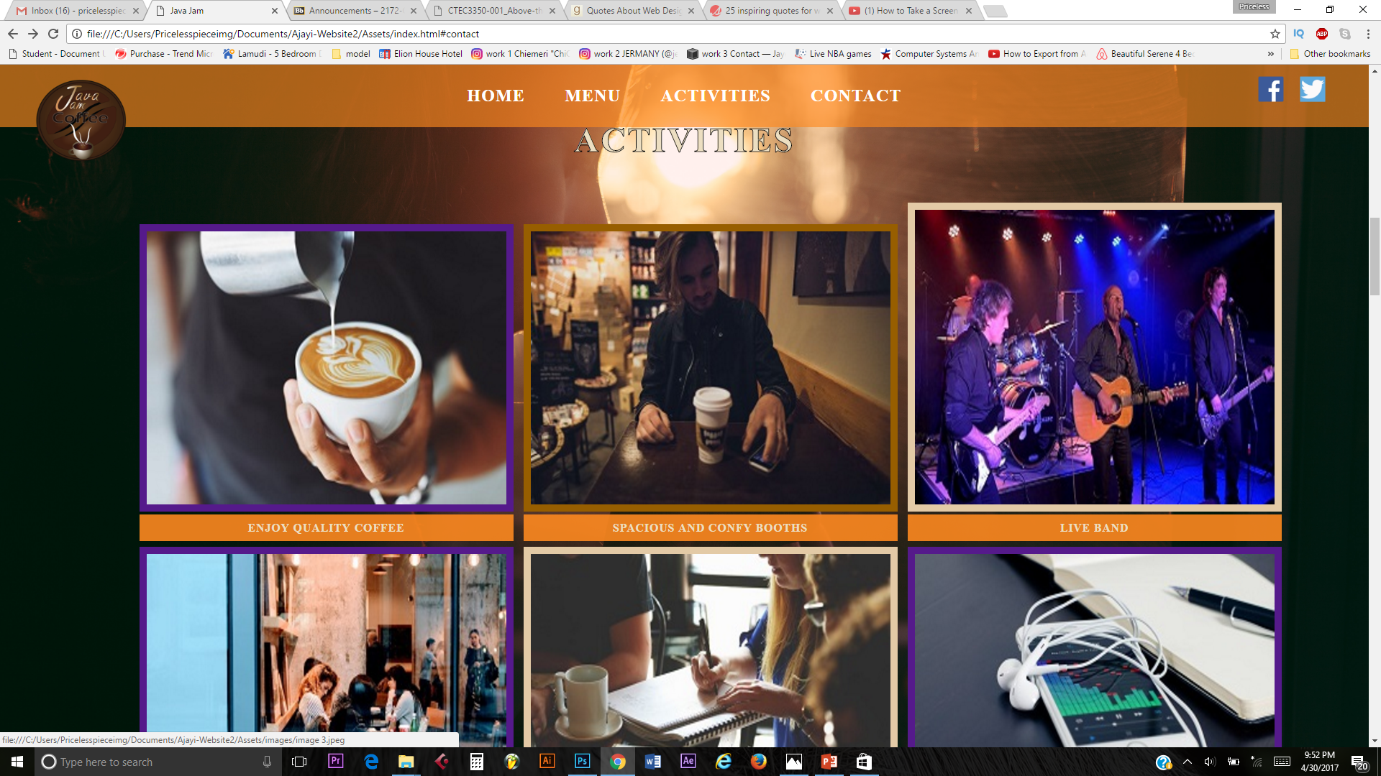
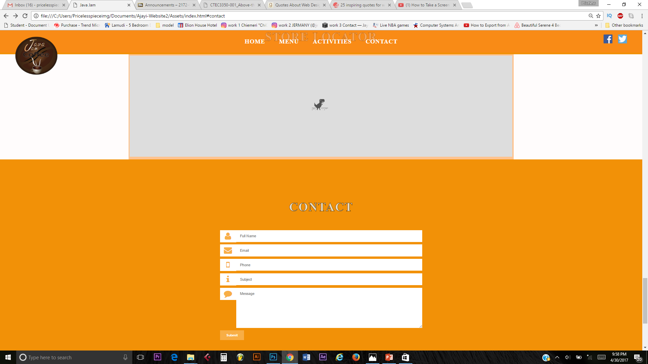
Design
Navigation
* Home
* Menu
* Activities
* Contact
Footer

Slide 4


Conclusion
What separates design from art is that design is meant to be… functional.” ― Cameron Moll
Analyze/Planning
!

